Slide 1
MACHINE LEARNING (AIML ZG565)

Slide 2
Session 10
(12th October,2025)

Slide 3
Course Plan
M1 | Introduction
M2 | Machine learning Workflow
M3 | Linear Models for Regression
M4 | Linear Models for Classification
M5 | Decision Tree
M6 | Instance Based Learning
M7 | Support Vector Machine
M8 | Bayesian Learning
M9 | Ensemble Learning
M10 | Unsupervised Learning
M11 | Machine Learning Model Evaluation/Comparison

Slide 4
Classification
Classification
Output is discrete e.g. f(x) : {yes, no, maybe}
f(x) : {0, 1} or {yes, no} Binary Classification
Objective: minimize mis-classification rate
Two kinds of Classifiers:
Probabilistic Generative Classifiers
Models aim to learn joint probability distribution P(X, Y)
Probabilistic Discriminative Classifiers
Models learn the decision boundary that separate the two classes

Slide 5
Agenda
Linear Classifiers
Maximum Margin Classification
Linear SVM
Soft Margin SVM
Nonlinear SVM
Multi-Class Problem

Slide 6
Linear Classifiers
w x + b>0
f(x,w,b) = sign(w x + b)
w x + b=0
denotes +1
denotes -1
How would you classify this data?
w x + b<0

Slide 7
Linear Classifiers
f(x,w,b) = sign(w x + b)
denotes +1
denotes -1
How would you classify this data?

Slide 8
Linear Classifiers
f(x,w,b) = sign(w x + b)
denotes +1
denotes -1
How would you classify this data?

Slide 9
Linear Classifiers
f(x,w,b) = sign(w x + b)
denotes +1
denotes -1
Any of these would be fine..
..but which is best?

Slide 10
Linear Classifiers
f(x,w,b) = sign(w x + b)
denotes +1
denotes -1
How would you classify this data?
Misclassified
to +1 class

Slide 11
Linear Classifiers
f(x,w,b) = sign(w x + b)
f(x,w,b) = sign(w x + b)
denotes +1
denotes -1
Define the margin of a linear classifier as the width that the boundary could be increased by before hitting a datapoint.

Slide 12
Maximum Margin
If hyperplane is oriented such that it is close to some of the points in your training set, new data may lie on the wrong side of the hyperplane, even if the new points lie close to training examples of the correct class.
Solution is maximizing the margin
f(x,w,b) = sign(w x + b)
denotes +1
denotes -1
The maximum margin linear classifier is the linear classifier with the, maximum margin.
This is the simplest kind of SVM (Called an LSVM)
Support Vectors are those datapoints that the margin pushes up against
Linear SVM

Slide 13
Support Vectors
Geometric description of SVM is that the max-margin hyperplane is completely determined by those points that lie nearest to it.
Points that lie on this margin are the support vectors.
The points of our data set which if removed, would alter the position of the dividing hyperplane

Slide 14
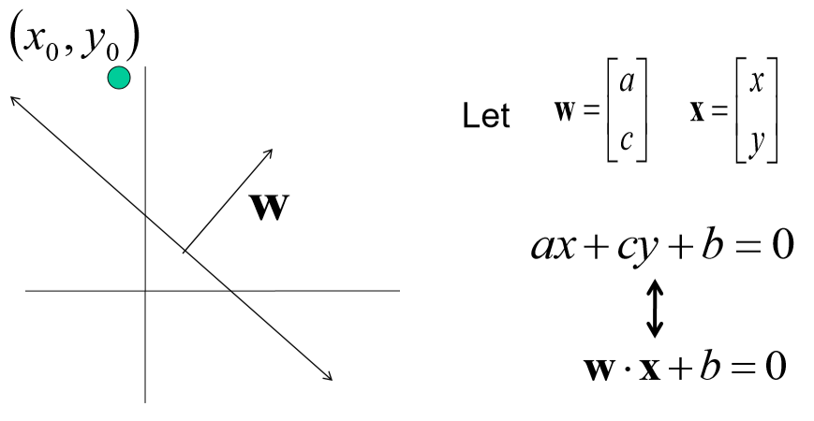
Line with 2 features: R2

Slide 15
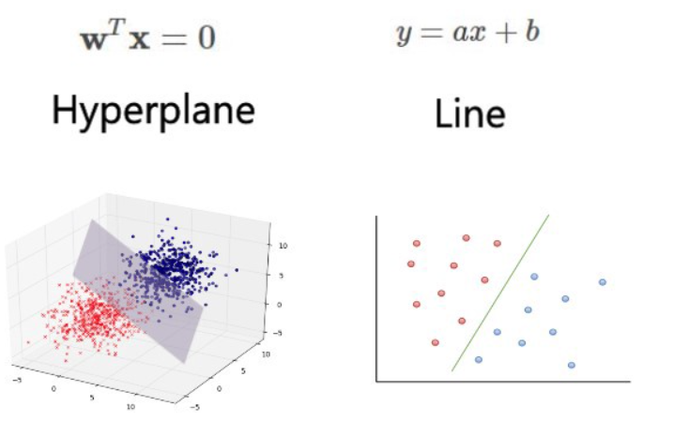
Example

Slide 16
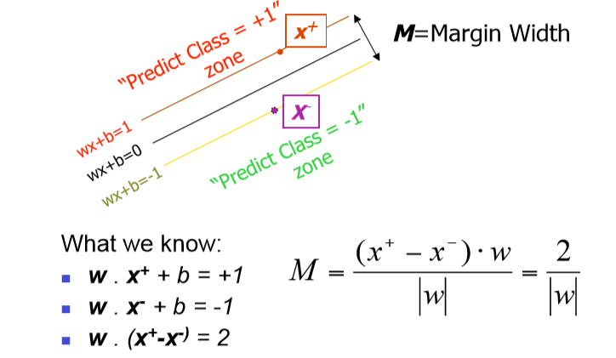
Linear SVM Mathematically

Slide 17
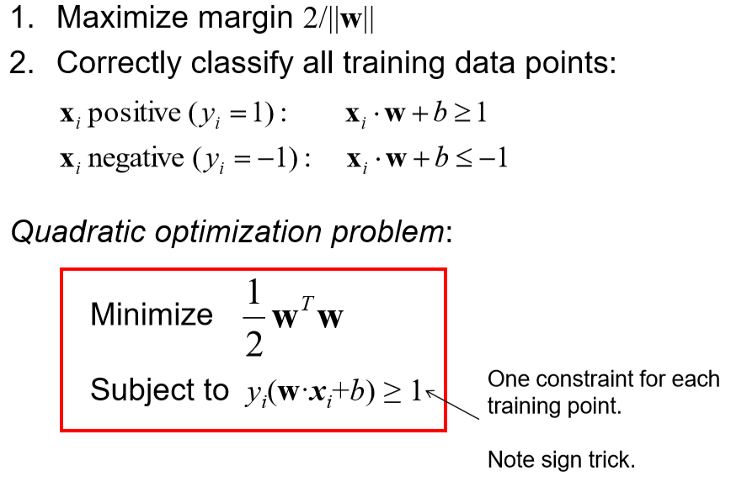
Solving the Optimization Problem

Slide 18
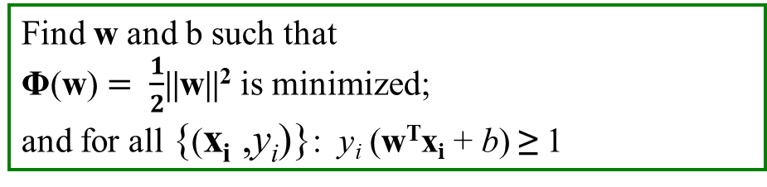
Solving the Optimization Problem
Find w and b such that
Φ(w) $= \frac{1}{2}$||w||² is minimized;
and for all {(x_{i} ,y_{i})}: y_{i} (w^{T}x_{i} + b) ≥ 1
← Primal
Need to optimize a quadratic function subject to linear inequality constraints.
All constraints in SVM are linear
Quadratic optimization problems are a well-known class of mathematical programming problems, and many (rather intricate) algorithms exist for solving them.
The solution involves constructing a dual problem where a Lagrange multiplier α_{i} is associated with every constraint in the primal problem

Slide 19
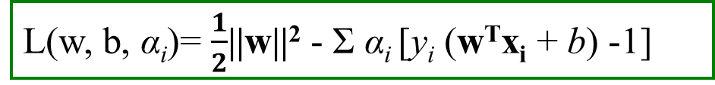
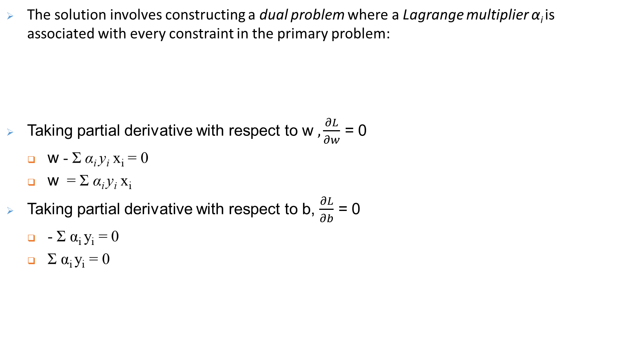
Solving the Optimization Problem
The solution involves constructing a dual problem where a Lagrange multiplier α_{i} is associated with every constraint in the primary problem:
Taking partial derivative with respect to w $, \frac{∂L}{∂w}$ = 0
w - Σ α_{i} y_{i} x_{i} = 0
w = Σ α_{i} y_{i} x_{i}
Taking partial derivative with respect to b, $\frac{∂L}{∂b}$ = 0
- Σ α_{i} y_{i} = 0
Σ α_{i} y_{i} = 0
L(w, b, α_{i})= $\frac{1}{2}$||w||² - Σ α_{i} [y_{i} (w^{T}x_{i} + b) -1]

Slide 20
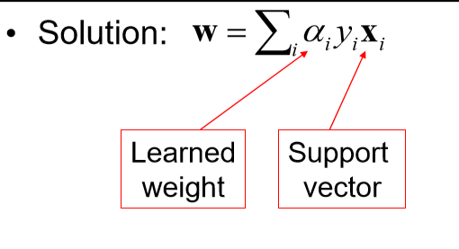
Solving the Optimization Problem

Slide 21
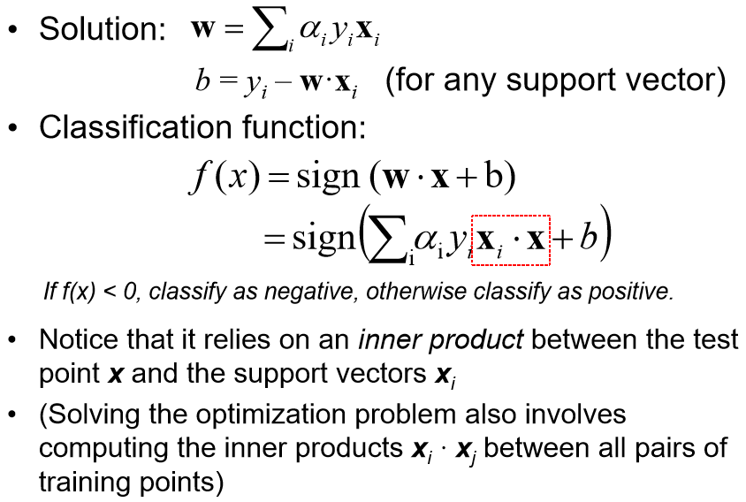
Solving the Optimization Problem

Slide 22
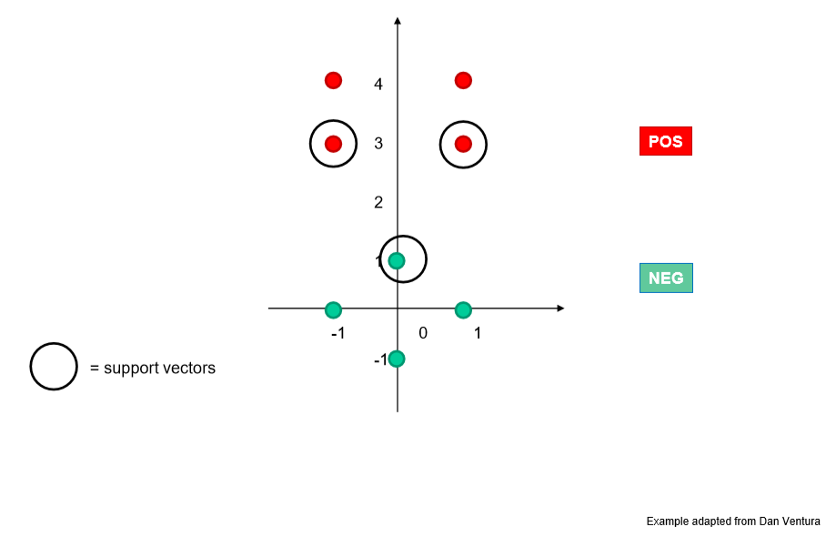
Example

Slide 23
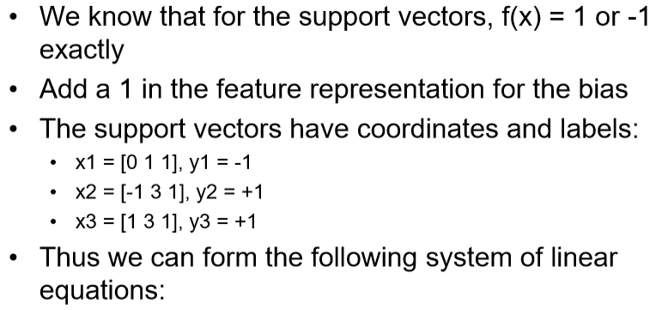
Solving for α

Slide 24
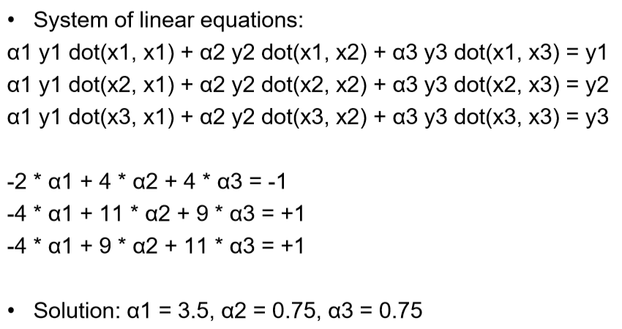
Solving for α

Slide 25
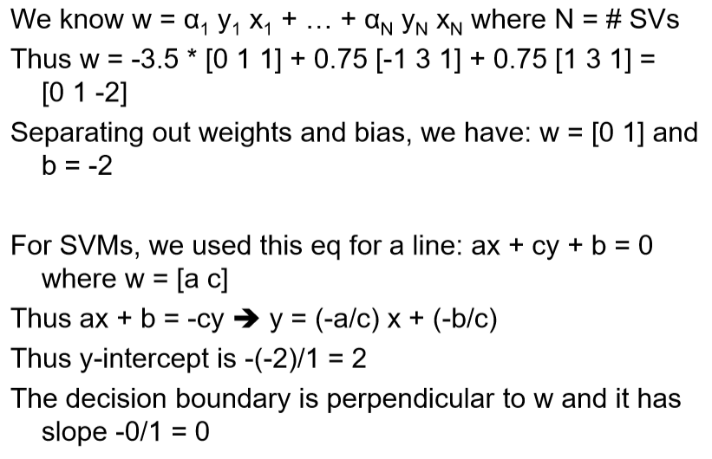
Solving for w and b

Slide 26
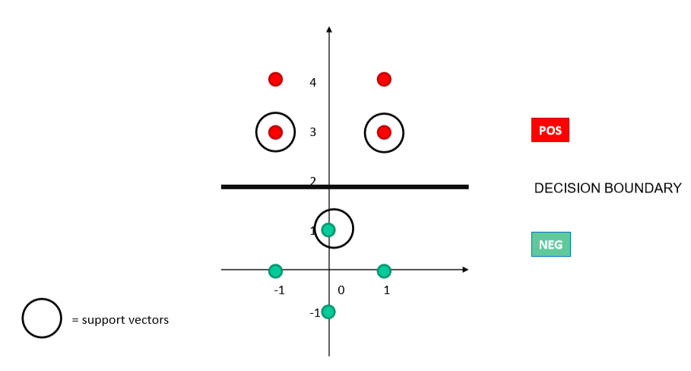
Decision boundary

Slide 27
Dataset with noise
denotes +1
denotes -1
Hard Margin: So far we require all data points be classified correctly
No training error
What if the training set is noisy?

Slide 28
Soft Margin Classification
Slack variables ξ_{i} can be added to allow misclassification of difficult or noisy examples.
What should our quadratic optimization criterion be?
Minimize

Slide 29
Slack Variable
Slack variable as giving the classifier some leniency when it comes to moving around points near the margin.
When C is large, larger slacks penalize the objective function of SVM’s more than when C is small.

Slide 30
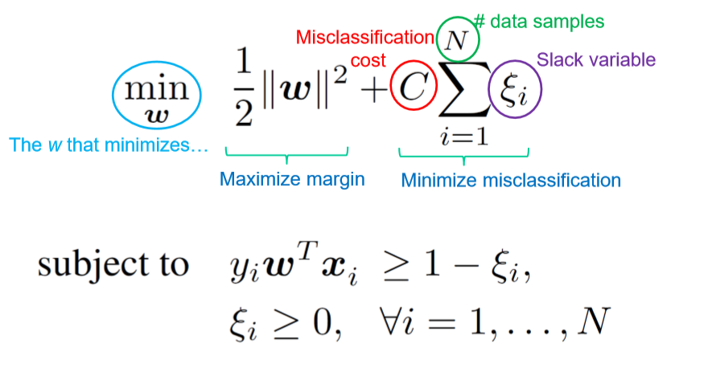
Soft Margin

Slide 31
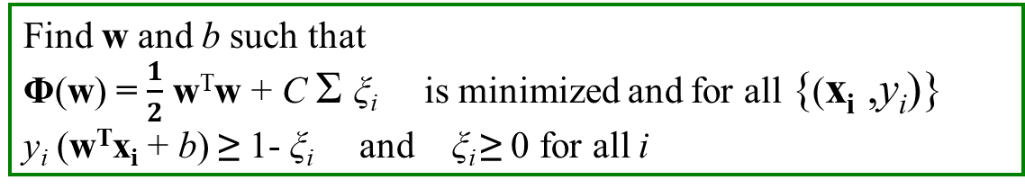
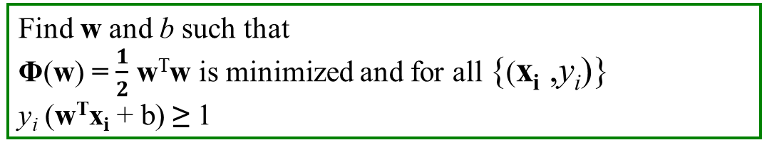
Hard Margin vs Soft Margin
Hard Margin:
Soft Margin incorporating slack variables:
Parameter C can be viewed as a way to control overfitting.
Find w and b such that
Φ(w) = $\frac{1}{2}$ w^{T}w is minimized and for all {(x_{i} ,y_{i})}
y_{i} (w^{T}x_{i} + b) ≥ 1
Find w and b such that
Φ(w) = $\frac{1}{2}$ w^{T}w + C Σ ξ_{i} is minimized and for all {(x_{i} ,y_{i})}
y_{i} (w^{T}x_{i} + b) ≥ 1- ξ_{i} and ξ_{i} ≥ 0 for all i

Slide 32
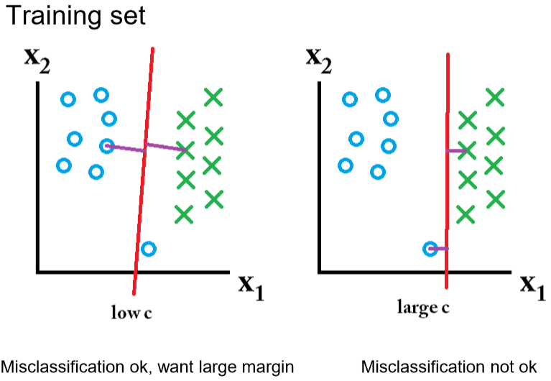
Effect of Margin size v/s misclassification cost

Slide 33
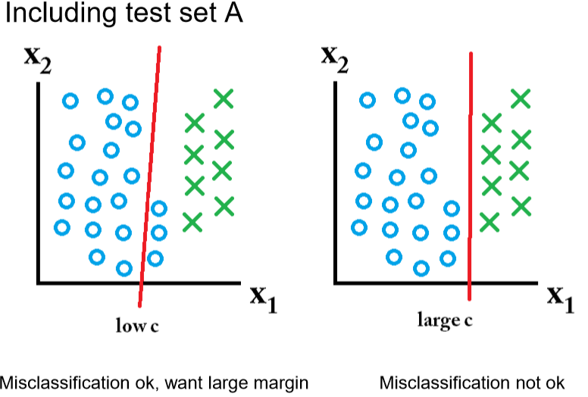
Effect of Margin size v/s misclassification cost

Slide 34
Effect of Margin size v/s misclassification cost

Slide 35
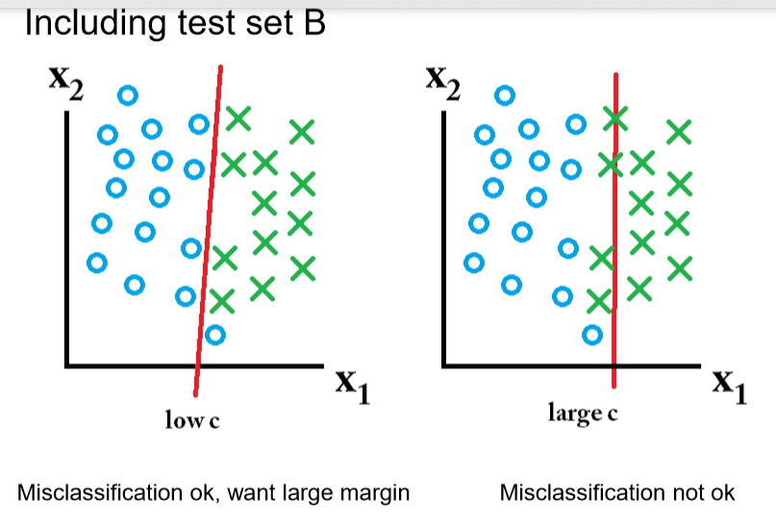
Effect of Margin size v/s misclassification cost

Slide 36
Linear SVMs: Overview
The classifier is a separating hyperplane.
Most “important” training points are support vectors; they define the hyperplane.
Quadratic optimization algorithms can identify which training points x_{i} are support vectors with non-zero Lagrangian multipliers α_{i}.
f(x) = Σα_{i}y_{i}x_{i}^{T}x + b

Slide 37
Support Vector Machines in overlapping class distributions & Kernels

Slide 38
Non-linear SVMs
Datasets that are linearly separable with some noise soft margin work out great:
But what are we going to do if the dataset is just too hard?
How about… mapping data to a higher-dimensional space:
0
x
0
x
x²

Slide 39
The “Kernel Trick”
The linear classifier relies on dot product between vectors
x_{i}^{T} . x_{j}
If every data point is mapped into high-dimensional space via some transformation Φ: x → φ(x), the dot product becomes:
K(x_{i}, x_{j})= φ(x_{i})^{T} φ (x_{j})
A kernel function is some function that corresponds to an inner product in some expanded feature space.

Slide 40
SVM Kernels
SVM algorithms use a set of mathematical functions that are defined as the kernel.
Function of kernel is to take data as input and transform it into the required form.
Different SVM algorithms use different types of kernel functions.
Example linear, nonlinear, polynomial, and sigmoid etc.

Slide 41
Non-linear SVMs: Feature spaces
General idea: the original input space can always be mapped to some higher-dimensional feature space where the training set is separable
Φ: x → φ(x)

Slide 42

Kernel Trick

Slide 43
Examples of Kernel Functions
Linear: K(x_{i},x_{j})= x_{i} ^{T}x_{j}
Polynomial of power p: K(x_{i},x_{j})= (1+ x_{i} ^{T}x_{j})^{p}
Gaussian (radial-basis function network):
Sigmoid: K(x_{i},x_{j})= tanh(β₀x_{i} ^{T}x_{j} + β₁)

Slide 44
Nonlinear SVM - Overview
SVM locates a separating hyperplane in the feature space and classify points in that space
It does not need to represent the space explicitly, simply by defining a kernel function
The kernel function plays the role of the dot product in the feature space.

Slide 45
Kernel Trick

Slide 46
Multi-Class Problem
Instead of just two classes , we now have C classes
Examples: predict which movie genre a viewer likes best
Possible answers : Action, Drama , thriller
Two approaches
one – vs – all
one –vs –one
One – vs – all(a.k.a .one – vs –others)
Train C classifiers
In each , pos = data from class I, neg = data from classes other than I
The class with the most confident prediction wins
Example
You have 4 classes , train 4 classifiers
1 vs others : score 3.5 2 vs others : score 6.2
3 vs others : score 1.4 4 vs others : score 5.5
Final prediction: class 2

Slide 47
Multi-Class Problem
One – vs – one (a.k.a.all – vs – all)
Train C binary classifiers(all pairs of classes)
They all vote for the label
Example
You have 4 classes , then train 6 classifiers
1 vs 2,1 vs 3,1 vs 4,2 vs 3,2 vs 4,3 vs 4
Votes: 1,1,4,2,4,4
Final prediction class 4

Slide 48
SVMs: Pros and cons
Pros
Kernel-based framework is very powerful, flexible
Often a sparse set of support vectors – compact at test time
Work very well in practice, even with very small training sample sizes
Solution can be formulated as a quadratic program (next time)
Many publicly available SVM packages: e.g. LIBSVM, LIBLINEAR, SVMLight
Cons
Can be tricky to select best kernel function for a problem
Computation, memory
At training time, must compute kernel values for all example pairs
Learning can take a very long time for large-scale problems

Slide 49
Good Web References for SVM
Text categorization with Support Vector Machines:learning with many relevant features - T. Joachims, ECML
A Tutorial on Support Vector Machines for Pattern Recognition, Kluwer Academic Publishers - Christopher J.C. Burges
http://www.cs.utexas.edu/users/mooney/cs391L/
https://www.coursera.org/learn/machine-learning/home/week/7
https://data-flair.training/blogs/svm-kernel-functions/
MIT 6.034 Artificial Intelligence, Fall 2010
https://stats.stackexchange.com/questions/30042/neural-networks-vs-support-vector-machines-are-the-second-definitely-superior
https://www.sciencedirect.com/science/article/abs/pii/S0893608006002796
https://medium.com/deep-math-machine-learning-ai/chapter-3-support-vector-machine-with-math-47d6193c82be
Radial basis kernel

Slide 50
Thank you

